Slide 1
Recitation 3
9/24/21
Greg, Will, & Sheil

Slide 2
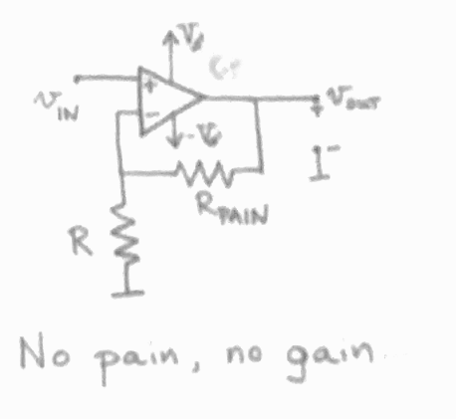
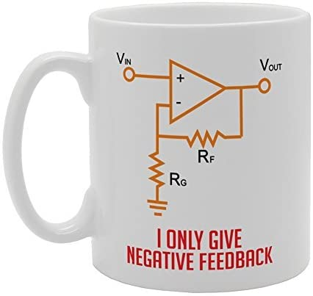
Op Amps
Golden Rules
Inputs draw no current
Inputs are at same potential (V)

Slide 3
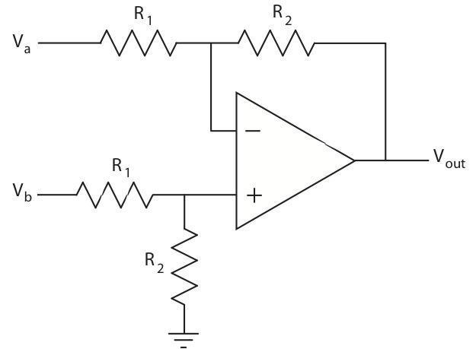
Problem 1 (a)

Slide 4
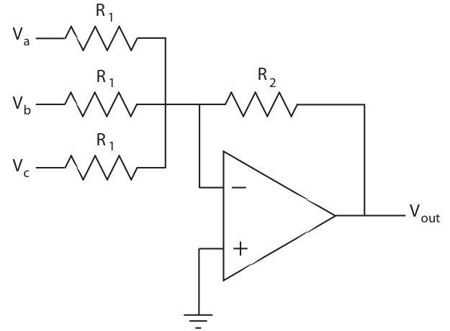
Problem 1 (b)

Slide 5
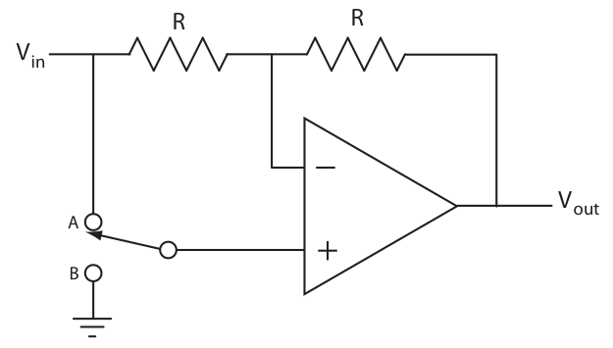
Problem 2

Slide 6
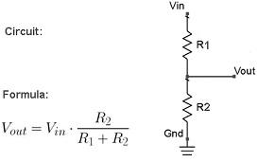
Problem 3
Note: A transresistance amplifier converts an input of current to an output of voltage.
Design a trans-resistive amplifier for a photo-transistor such that:
Circuit outputs 2.5V with no light falling on the sensor
Output voltage that rises with increasing light levels
You have a unipolar +5V supply
TODO
Circuit Diagram
Expression relating photo-transistor current to output voltage
Voltage Divider

Slide 7
Problem 4 - Non-inverting Summer
In problem 1 you analyzed a circuit that was designed to add multiple analog signals together, but you may have noticed that it also inverts the signal (or, if you didn't, now you will). While you could add a second inverting op-amp stage to bring this back into the positive domain, there are times when this is not possible (for instance, when you have a unipolar supply).
Can you design a circuit to use a single op amp and a unipolar supply to add two signals together without inverting the result?

Slide 8
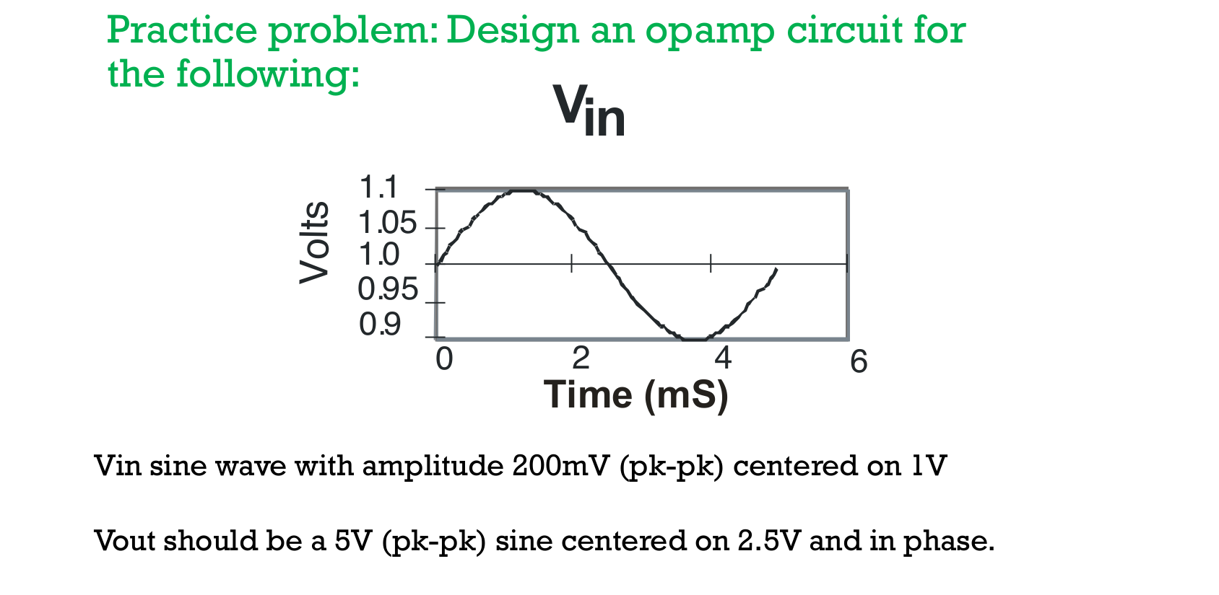
Lecture Problem

Slide 9
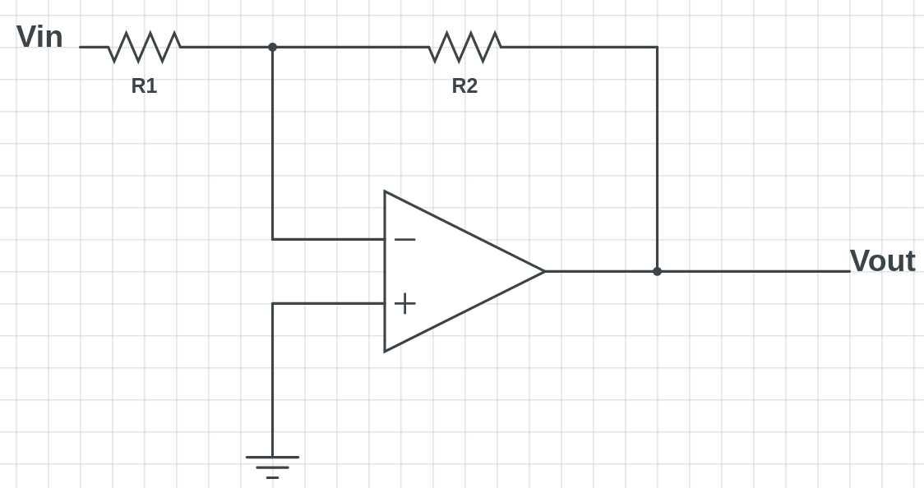
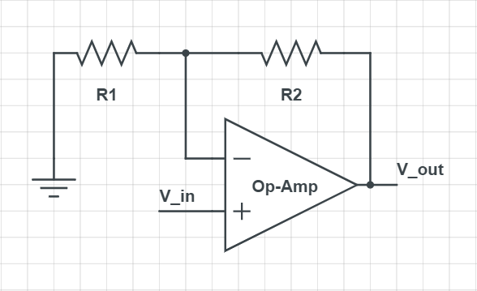
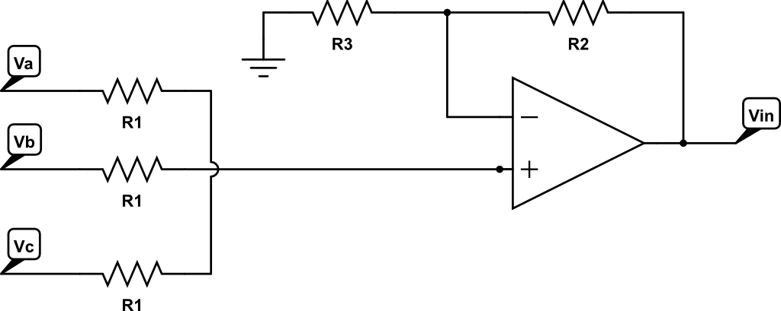
Common Op Amp Designs
Inverting Amplifier
Inverting adder
Non-Inverting Amplifier
Non-Inverting adder

